Slide 1
PRISM
PRactical Improvement in Sales & Marketing
( Sales/ After sales Process )

Slide 2
Index Sheet
CUSTOMER DATA BASE CREATION
CUSTOMER DATA BASE DASH BOARD
TARGET SETTING – GROUP / INDIVIDUAL
TARGET DASH BOARD AND MAPPING
BP-L TRACKER
BP-L DASH BOARD
IQD – TRACKER
IQD – DASH BOARD
NF – TRACKER
NF – DASH BOARD
OVERVIEW – BP-L-I-Q-D-N-F DASH BOARD

Slide 3
PRISM
Benefits & Methodology

Slide 4
Benefits
Upgrades Sale’s and Marketing Approach
Systematic Management - Start to End Sales Process
Visualization of Potential Business Hubs
Effective Customer Data Base Management & Utilization
Define & Visualize Live Performance – Individual and Group
Live tracking of Sales Engineers on site

Slide 5
IMPLEMENTATION LEVELS
Customer related to Business Model
STAGE 1
BUSINESS PROSPECT CREATION
STAGE 2
LEAD GENERATION
STAGE 3
IDENTIFICATION
STAGE 4
STAGE 5
STAGE 6
STAGE 7
QUALIFICATION
DEVELOPMENT
NEGOTIATION
FINALIZATION
Customer Willing to Buy Service after 90/60/30 Days
Customer Willing to Buy Sale/Service
Check Customer Financial Eligibility
Demo to Customer / Quote Submission
Price Finalization
Deal Closure
(Deal Won/Lost )

Slide 6
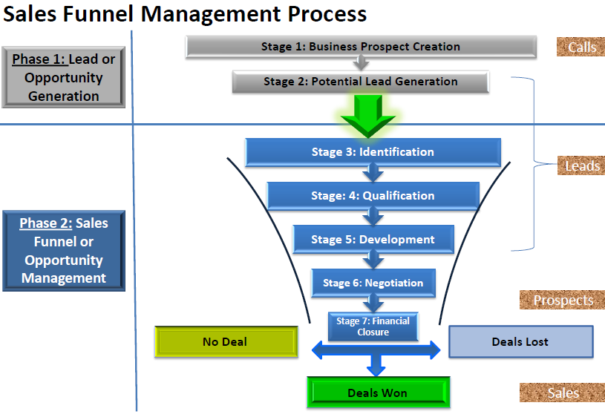
SALES FUNNEL MANAGEMENT PROCESS

Slide 7
SALES FUNNEL CONCEPT
BPS
5000
1:5
CALLS
1000
CALL TO LEAD RATIO
1:10
1 LEAD OUT OF EVERY 10 VALID CALLS
LEADS
100
LEAD TO PROSPECT RATIO
1:5
PROSPECTS
20
PROSPECT TO SALE RATIO
1:2
SALE
10
Process Stages | Calls to Leads |  | Leads to Prospects |  |  | Prospects to Sales
IQDNF Process | BP | L | I | Q | D | N | F
Metrics | # of Leads |  | # of Prospects |  |  | # of Sales
Tool for Review | BP-L Tracker |  | IQD Tracker |  |  | NF Tracker

Slide 8
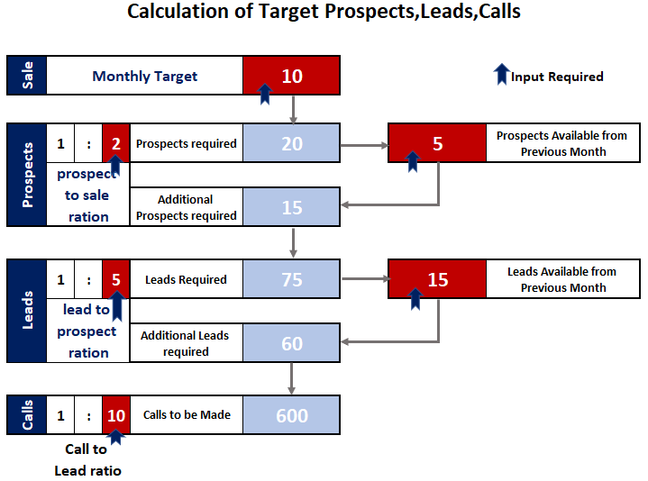
Calls to Sale Calculator

Slide 9
PRISM
Practical Interaction

Slide 10
MAIN SCREEN
PRISM
PRactical Improvement in Sales & Marketing
Main Page
Data Base
Set Target
In Progress
Performance
Live Location

Slide 11
PRISM
Customer Data Base View and Edit Screen

Slide 12
CUSTOMER DETA BASE MAIN SCREEN
PRISM
PRactical Improvement in Sales & Marketing
Back to Main Page
Refer Sheet for Details
Search
Add /Edit Customer
Export
Sl.no | Customer ID Number | Added on Date | Added By User | HUB | SUB HUB | Name of the Customer | Contact Person | Source of Data | Contact number | Address | Email Id | GPS Location of Office | Application | Segment | Key/ Non Key Customer | Fleet Details | Testimonials | Referrals
1 | xxxxxxx | aaaaaaa | cccccccc | aaaaaa | ccccccc | ffffffffff | hhhhhh | Demo | hhhhhh | jjjjjjjjj | ddd | dddddd | ggggg | ffffffffff | ggggggg | 10 | Add | Add
2 | xxxxxxx | bbbbbbb | ccccccc | sssssss | ccccccc | ggggggg | hhhhhh | Referral | hhhhhh | jjjjjjj | ddd | rrrrrrrr | hhhhh | hhhhhhh | ggggggg | 8 | Add | Add
3 | xxxxxxx | ccccccccc | ccccccc | ddddd | ccccccc | hhhhhh | hhhhhh | Walkin | hhhhhh | mmmm | dd | ttttttttt | jjjjjjjj | hhhhhh | ggggggg | 1 | Add | Add
4 | wwwww | eeeeee e | eeeeeee |  |  | eeeeee |  |  |  |  |  |  |  |  |  | Click to Update | Add | Add
5
6
7
8
9
10
11
12
13
14
15
16
17

Slide 13
CUSTOMER DETA BASE INPUT SCREEN
PRISM
PRactical Improvement in Sales & Marketing
Back to Main Screen
Add / Edit Customer Details
Hub
E-mail ID
Fleet Details
Click to Add
Sub-hub
GPS Location of Office
Remarks
Click to Add Location
Name of Customer
Key/Non-Key Customer
Contact Person
Auto Update from Fleet Details
Source of Customer Data
Contact Number
Application of Usage
Office Address
Segment of Customer
SAVE
EDIT

Slide 14
SOURCE OF DATA BASE
Tender Web Sites
Back to Main Screen
Referrals
Data from Support Departments
Direct Marketing
Enquiry Calls
DATA BASE

Slide 15
PRISM
Target Setting Screen

Slide 16
“SET TARGET ” SCREEN
PRISM
PRactical Improvement in Sales & Marketing
Back to Main Page
Group Target
Individual Target

Slide 17
“SET TARGET ” SCREEN – GROUP TARGET
PRISM
PRactical Improvement in Sales & Marketing
Back to Main Screen
INPUT
TOTAL INDUSTRIAL VOLUME ( TIV ) – 2021
662
YEARLY SALE TARGET - 2021
TARGET % | TARGET NUMBERS
30 | 199
MONTHLY SALE TARGET
JAN-21 | FEB-21 | MAR-21 | APR-21 | MAY-21 | JUN-21 | JUL-21 | AUG-21 | SEP-21 | OCT-21 | NOV-21 | DEC-21 | SUM
10 | 10 | 8 | 8 | 8 | 8 | 8 | 8 | 8 | 8 | 8 | 8 | 100
20 | 20 | 16 | 16 | 16 | 16 | 16 | 16 | 16 | 16 | 16 | 16 | 199
Target %
Target Numbers

Slide 18
“SET TARGET ” SCREEN – INDIVIDUAL TARGETS
PRISM
PRactical Improvement in Sales & Marketing
Back to Main Screen
MONTH
SALE TARGET
NO.OF HUBS
Cumulative of I+Q+D
JAN-2021
20
4
Cumulative of N+F
SALES FUNNEL MANAGEMENT
Lead
to Prospect
Calls to Leads
SALE TARGET
Prospect
to Sale
Target
2000
40 | 200 | 2000
100%
14
40
200
20
GROUP
View Details
Carry Over
5
30
-
Actual
35
145
1450
35%
6
Re-Assign
Target
40 | 200 | 2000
HUB-1
7
Carry Over
Actual
4
Re-Assign
Target
40 | 200 | 2000
25%
5
Carry Over
HUB-2
Actual
3
Target
40 | 200 | 2000
20%
4
Re-Assign
Carry Over
HUB-3
Actual
Re-Assign
Target
40 | 200 | 2000
20%
1
4
Carry Over
HUB-4
Actual
We can Generate Sales Funnel Process for Sales Engineer Month wise and Hub Wise

Slide 19
“SET TARGET ” RE-ASSIGN SCREEN
PRISM
PRactical Improvement in Sales & Marketing
Back to Main Screen
HUB-1
NO.OF DSR
AVG.DSR
SALE TARGET
SALE TARGET
SALE TARGET
SALE TARGET
4
14
6
7
2
GROUP
20
HIB-1
7
ASSIGN TO
MODEL
NO.OF UNITS
Re-Assign
582
2
RAKESH
Re-Assign
2
Re-Assign
1
Re-Assign
1
BACK
SAVE

Slide 20
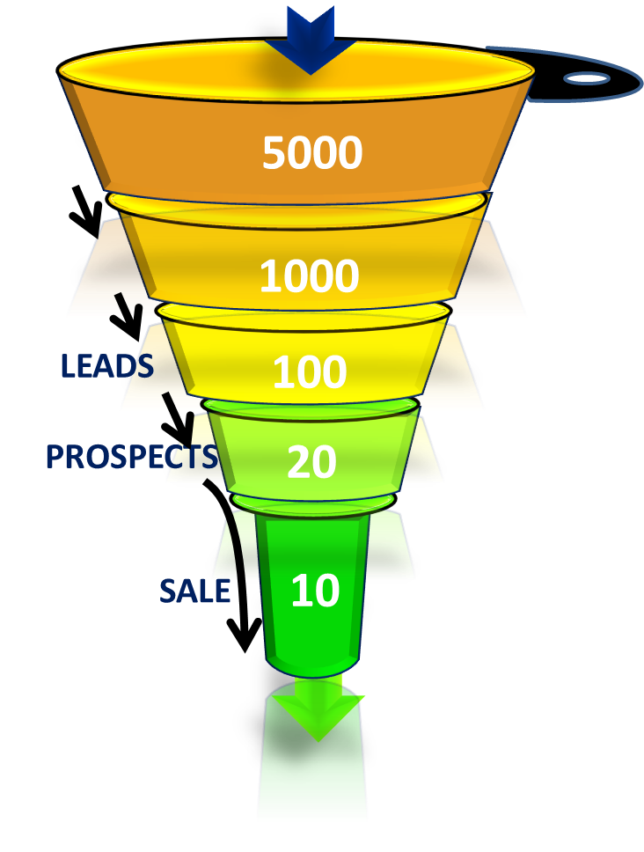
“SET TARGET – SALES FUNNEL ” RE-ASSIGN SCREEN - RAKESH
PRISM
PRactical Improvement in Sales & Marketing
Back to Main Screen
RAKESH
SALE TARGET
SALE TARGET
SALE TARGET
14
1
2
GROUP
20
HIB-1
2
HUB
SUB HUB
MODEL
NO.OF UNITS
WEEK - 1
DUBAI
1
AL QUOZ
WEEK - 2
DUBAI
WEEK - 3
DUBAI
1
400
4
WEEK - 4
2
DUBAI
BACK
SAVE

Slide 21
“SET TARGET ” SCREEN - INPUT
PRISM
PRactical Improvement in Sales & Marketing
Back to Main Screen
SALES FUNNEL MANAGEMENT
INPUT
HUB | REVISED SALES TARGET | PROSPECT TO SALE RATIO |  |  | LEADS TO PROSPECT |  |  | CALLS TO LEADS
HUB-1 |  | 1 | : | 2 | 1 | : | 5 | 1 | : | 10
HUB-2 |  | 1 | : | 2 | 1 | : | 4 | 1 | : | 12
HUB-3 |  | 1 | : | 3 | 1 | : | 6 | 1 | : | 15
HUB-4 |  | 1 | : | 2 | 1 | : | 5 | 1 | : | 12
AUTO UPDATE FROM MAIN TARGET SCREEN
BACK
SAVE

Slide 22
View Group Target
Coverage Mapping Target
Coverage Mapping
Actuals VS Target

Slide 23
PRISM
SALES ENGINEER SCREEN

Slide 24
SALES ENGINEER - MAIN SCREEN
PRISM
PRactical Improvement in Sales & Marketing
Mr. Rakesh- E00203
Live Location-On
Sales Kit
Data Base
Lead Tracker
Performance
Follow up Calendar

Slide 25
SALES ENGINEER – SALES KIT SCREEN
PRISM
PRactical Improvement in Sales & Marketing
Mr. Rakesh- E00203
Live Location-On
Back to Main Screen
ADD / EDIT
Search e-mail ID
View/Add/Edit
Data Base
Company Profile
Business Card
Product Catalogue
Sales Kit
Testimonials
Application Videos
Testimonials
HUB
SUB-HUB
SEND

Slide 26
SALES ENGINEER - CUSTOMER DETA BASE SCREEN
PRISM
PRactical Improvement in Sales & Marketing
Back to Main Screen
Search
Add / Edit Customer
Export
Sl.no | Customer ID Number | Added on Date | Added By User | HUB | SUB HUB | Name of the Customer | Contact Person | Contact number | Address | Email Id | GPS Location of Office | Application | Segment | Key/ Non Key Customer | Fleet Details | Testimonials | Not Opted | L0 | L1 | L2 | L3 | Next Followup Date
1 | xxxxxxx | aaaaaaa | cccccccc | aaaaaa | ccccccc | ffffffffff | hhhhhh | hhhhhh | jjjjjjjjj | ddd | dddddd | ggggg | ffffffffff | ggggggg | 10
2 | xxxxxxx | bbbbbbb | ccccccc | sssssss | ccccccc | ggggggg | hhhhhh | hhhhhh | jjjjjjj | ddd | rrrrrrrr | hhhhh | hhhhhhh | ggggggg | 8
3 | xxxxxxx | ccccccccc | ccccccc | ddddd | ccccccc | hhhhhh | hhhhhh | hhhhhh | mmmm | dd | ttttttttt | jjjjjjjj | hhhhhh | ggggggg | 1
4 | wwwww | eeeeee e | eeeeeee |  |  | eeeeee |  |  |  |  |  |  |  |  | Click to Update
5 |  |  |  |  |  |  |  |  |  |  |  |  |  |  | Click to Update
6 |  |  |  |  |  |  |  |  |  |  |  |  |  |  | Click to Update
7 |  |  |  |  |  |  |  |  |  |  |  |  |  |  | Click to Update
8 |  |  |  |  |  |  |  |  |  |  |  |  |  |  | Click to Update
9 |  |  |  |  |  |  |  |  |  |  |  |  |  |  | Click to Update
10 |  |  |  |  |  |  |  |  |  |  |  |  |  |  | Click to Update
11 |  |  |  |  |  |  |  |  |  |  |  |  |  |  | Click to Update
12 |  |  |  |  |  |  |  |  |  |  |  |  |  |  | Click to Update
13 |  |  |  |  |  |  |  |  |  |  |  |  |  |  | Click to Update
14 |  |  |  |  |  |  |  |  |  |  |  |  |  |  | Click to Update
15 |  |  |  |  |  |  |  |  |  |  |  |  |  |  | Click to Update
16 |  |  |  |  |  |  |  |  |  |  |  |  |  |  | Click to Update
17 |  |  |  |  |  |  |  |  |  |  |  |  |  |  | Click to Update

Slide 27
SALES ENGINEER – CUSTOMER FOLLOWUP SCREEN
PRISM
PRactical Improvement in Sales & Marketing
Mr. Rakesh- E00203
Live Location-On
Back to Main Screen
Customer : Arjun Contracting
Not Opted
L0
After 90 Days
L1
In 90 Days
L2
After 30 Days
L3
In 30 Days
Mode of Contact
Multi Media Files
Interaction Date & Time
Interaction Details
Next Follow up Date & Time
Move BP to Lead – L3 Stage
“LEAD GENERATED”
Pop Up Msg to TL
Save
Calendar View report to get up dated. Reminders to be triggered

Slide 28
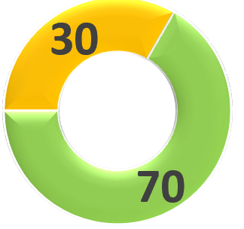
CUTOMER DATA BASE DASH BOARD
PRISM
PRactical Improvement in Sales & Marketing
Back to Main Screen
From
To
HUB
SUB HUB
SALES ENGINEER
Export

Slide 29
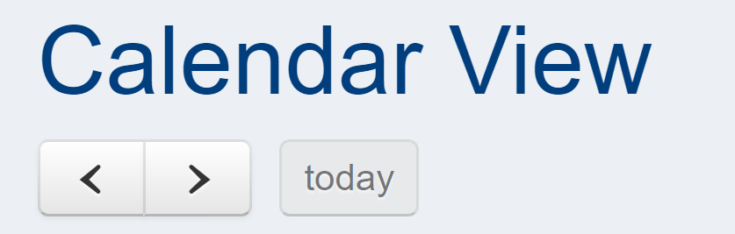
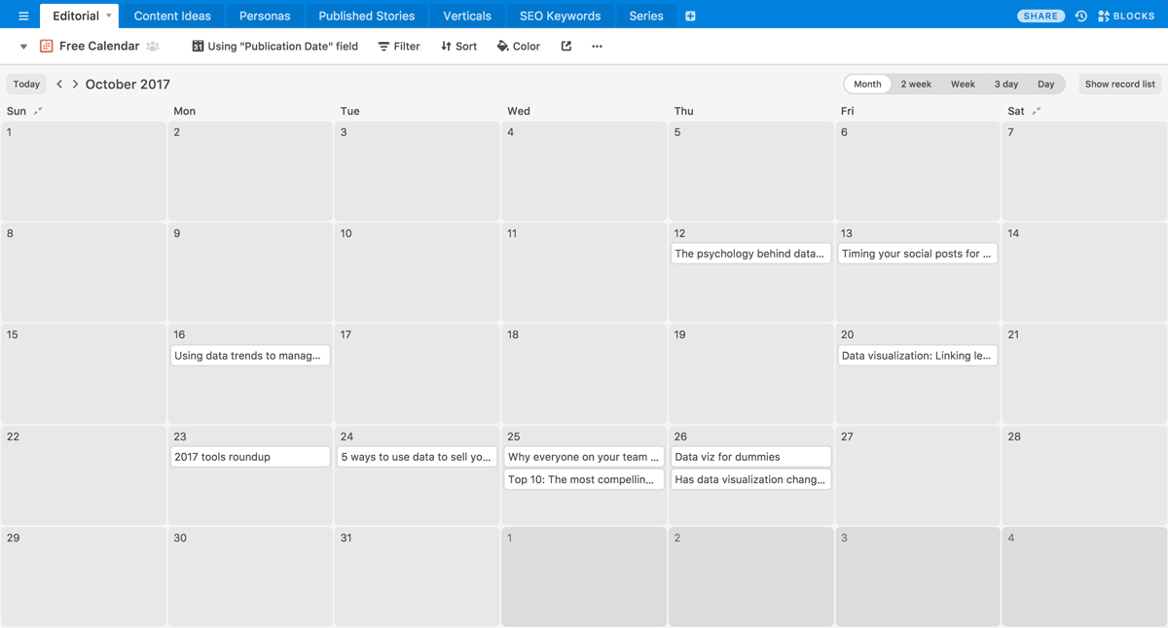
SALES ENGINEER – CALENDER VIEW
PRISM
PRactical Improvement in Sales & Marketing
View By Hub
View By Date
View By Sales Engineer
JAN - 2021
Export
Export
Export

Slide 30
DashBoard - LEADS
07/11/2020
LEADS DASHBOARD
Live
SELECT MONTH
All
Sales Engineer
Hub
Sub Hub
Customer
Combination of Sales Engineers, Hubs and Sub Hubs
Leads Generated
( Month to Date )
Calls
( Month to Date )
Calls to Lead Ratio
( Month to Date )
3
1345
2.8
Response Time
Line Issues
Lead Generation
( Year To Date )
Calls
( Year To Date )
Calls to Lead Ratio
( Year to Date )
13
12800
5.5

Slide 31
PRISM
TEAM LEADER SCREEN

Slide 32
TEAM LEADER- MAIN SCREEN
PRISM
PRactical Improvement in Sales & Marketing
Sales Kit
Data Base
IQD Tracker
Performance
Follow up Calendar

Slide 33
TEAM LEADER– SALES KIT SCREEN
PRISM
PRactical Improvement in Sales & Marketing
Mr. Sam- E00101
Live Location-On
Back to Main Screen
ADD / EDIT
Search e-mail ID
View/Add/Edit
Data Base
Company Profile
Business Card
Product Catalogue
Sales Kit
Testimonials
Application Videos
Testimonials
HUB
SUB-HUB
SEND

Slide 34
TEAM LEADER – CUSTOMER FOLLOWUP SCREEN
PRISM
PRactical Improvement in Sales & Marketing
Mr. Sam- E00101
Back to Main Screen
Customer : Arjun Contracting
L3
LEAD
I
IDENTIFIED
Q
QUALIFIED
D
DEVELOP
Mode of Contact
Multi Media Files
Interaction Date & Time
Interaction Details
Next Follow up Date & Time
Move Prospect to Negotiation Stage
“PROSPECT GENERATED”
Pop Up Msg to Manager
Save
Calendar View report to get up dated. Reminders to be triggered

Slide 35
TEAM LEADER – CALENDER VIEW
PRISM
PRactical Improvement in Sales & Marketing
View By Hub
View By Date
View By Team Leader
JAN - 2021
Export
Export
Export

Slide 36
DashBoard - PROSPECTS
07/11/2020
PROSPECT DASHBOARD
Live
SELECT MONTH
All
Sales Engineer
Hub
Sub Hub
Customer
Combination of Sales Engineers, Hubs and Sub Hubs
Leads Available
( Month to Date )
Prospects Generated
( Month to Date )
Leads to Prospect Ratio
( Month to Date )
3
3
2.8
Response Time
Line Issues
Response Time
Line Issues
Available Leads
( Year To Date )
Prospects Generated
( Year To Date )
Leads to Prospect Ratio
( Year to Date )
13
12800
5.5

Slide 37
PRISM
MANAGER NF SCREEN

Slide 38
MANAGER - MAIN SCREEN
PRISM
PRactical Improvement in Sales & Marketing
Sales Kit
Data Base
NF Tracker
Performance
Follow up Calendar

Slide 39
MANAGER – SALES KIT SCREEN
PRISM
PRactical Improvement in Sales & Marketing
Mr. Jim- E00102
Back to Main Screen
ADD / EDIT
Search e-mail ID
View/Add/Edit
Data Base
Company Profile
Business Card
Product Catalogue
Sales Kit
Testimonials
Application Videos
Testimonials
HUB
SUB-HUB
SEND

Slide 40
MANAGER – CUSTOMER FOLLOWUP SCREEN
PRISM
PRactical Improvement in Sales & Marketing
Mr. Jim- E00102
Back to Main Screen
Customer : Arjun Contracting
D
DEVELOP
N
NEGOTIATION
F
FINALIZATION
SALE WON
SALE LOST
Mode of Contact
Multi Media Files
Interaction Date & Time
Interaction Details
Next Follow up Date & Time
Save
Calendar View report to get up dated. Reminders to be triggered

Slide 41
MANAGER – CALENDER VIEW
PRISM
PRactical Improvement in Sales & Marketing
View By Hub
View By Date
View By Team Manager
JAN - 2021
Export
Export
Export

Slide 42
DashBoard - Sale
07/11/2020
SALE DASHBOARD
Live
SELECT MONTH
All
Sales Engineer
Hub
Sub Hub
Customer
Combination of Sales Engineers, Hubs and Sub Hubs
Prospects Available
( Month to Date )
Converted to Sale
( Month to Date )
Prospect to Sale Ratio
Month to Date )
3
3
2.8
Response Time
Line Issues
Response Time
Line Issues
Prospects Available
( Year To Date )
Converted to Sale
( Year To Date )
Prospect to Sale Ratio
( Year to Date )
13
12800
5.5

Slide 43
PRISM
In-Progress View Screen

Slide 44
IN-PROGRESS VIEW SCREEN – LIVE – ACCESS TO ALL TEAM MEMBERS
PRISM
PRactical Improvement in Sales & Marketing
Back to Main Screen
Export
CALL TO SALE DETAILS
Sl No | Hub | SUB HUB | DSE Name | WEEK |  |  |  | Sales Target | DSE's Report |  |  |  |  | TL's Report |  |  |  | ASM's Report
 |  |  |  |  |  |  |  |  | Calls |  |  |  |  | Leads |  |  |  | Prospects |  | Sales
 |  |  |  | W1 | W2 | W3 | W4 |  | Calls | L0 | L1 | L2 | L3 | L | I | Q | D | N | F | Won | Lost
1 | H-1 | SH-1 | RAKESH | 1 | 0 | 0 | 0 | 1 | 0 | 0 | 0 | 0 | 0 | 0 | 0 | 0 | 0 | 0 | 0 | 0 | 0
2 | H-1 | SH-2 | RAKESH | 0 | 1 | 0 | 0 | 1 | 0 | 0 | 0 | 0 | 0 | 0 | 0 | 0 | 0 | 0 | 0 | 0 | 0
3 | H-1 | SH-3 | ROHITH | 0 | 0 | 0 | 0 | 1 | 0 | 0 | 0 | 0 | 0 | 0 | 0 | 0 | 0 | 0 | 0 | 0 | 0
4 | H-1 | SH-4 | ROHITH | 0 | 0 | 0 | 1 | 1 | 0 | 0 | 0 | 0 | 0 | 0 | 0 | 0 | 0 | 0 | 0 | 0 | 0
5 | H-2 | SH-1 | ROHITH | 0 | 0 | 0.44685 | 0 | 1 | 0 | 0 | 0 | 0 | 0 | 0 | 0 | 0 | 0 | 0 | 0 | 0 | 0
6 | H-2 | SH-2 | ROHITH | 0 | 0 | 0 | 0.8937 | 1 | 0 | 0 | 0 | 0 | 0 | 0 | 0 | 0 | 0 | 0 | 0 | 0 | 0
7 | H-2 | SH-3 | ROHITH | 1 | 0 | 0 | 0 | 1 | 0 | 0 | 0 | 0 | 0 | 0 | 0 | 0 | 0 | 0 | 0 | 0 | 0
8 | H-2 | SH-4 | RANA | 0 | 0.74475 | 0 | 0 | 1 | 0 | 0 | 0 | 0 | 0 | 0 | 0 | 0 | 0 | 0 | 0 | 0 | 0
9 | H-3 | SH-1 | RANA | 1 | 0 | 0 | 0 | 1 | 0 | 0 | 0 | 0 | 0 | 0 | 0 | 0 | 0 | 0 | 0 | 0 | 0
10 | H-3 | SH-2 | RANA | 0 | 1 | 0 | 0 | 1 | 0 | 0 | 0 | 0 | 0 | 0 | 0 | 0 | 0 | 0 | 0 | 0 | 0
11 | H-3 | SH-3 | RANA | 0 | 0 | 0 | 0 | 1 | 0 | 0 | 0 | 0 | 0 | 0 | 0 | 0 | 0 | 0 | 0 | 0 | 0
12 | H-3 | SH-4 | RANA | 0 | 0 | 0 | 1 | 1 | 0 | 0 | 0 | 0 | 0 | 0 | 0 | 0 | 0 | 0 | 0 | 0 | 0
13 | H-4 | SH-1 | AKASH | 0 | 0 | 0.44685 | 0 | 1 | 0 | 0 | 0 | 0 | 0 | 0 | 0 | 0 | 0 | 0 | 0 | 0 | 0
14 | H-4 | SH-2 | AKASH | 0 | 0 | 0 | 0.8937 | 1 | 0 | 0 | 0 | 0 | 0 | 0 | 0 | 0 | 0 | 0 | 0 | 0 | 0
15 | H-4 | SH-3 | AKASH | 1 | 0 | 0 | 0 | 1 | 0 | 0 | 0 | 0 | 0 | 0 | 0 | 0 | 0 | 0 | 0 | 0 | 0
16 | H-4 | SH-4 | AKASH | 0 | 0.993 | 0 | 0 | 1 | 0 | 0 | 0 | 0 | 0 | 0 | 0 | 0 | 0 | 0 | 0 | 0 | 0
17 | H-5 | SH-1 | KIRAN | 1 | 0 | 0 | 0 | 1 | 0 | 0 | 0 | 0 | 0 | 0 | 0 | 0 | 0 | 0 | 0 | 0 | 0
18 | H-5 | SH-2 | KIRAN | 0 | 1 | 0 | 0 | 1 | 0 | 0 | 0 | 0 | 0 | 0 | 0 | 0 | 0 | 0 | 0 | 0 | 0
19 | H-5 | SH-3 | KIRAN | 1 | 0 | 1 | 0 | 1 | 0 | 0 | 0 | 0 | 0 | 0 | 0 | 0 | 0 | 0 | 0 | 0 | 0
20 | H-5 | SH-4 | KIRAN | 0 | 0 | 0 | 1 | 1 | 0 | 0 | 0 | 0 | 0 | 0 | 0 | 0 | 0 | 0 | 0 | 0 | 0
21 | H-6 | SH-1 | PHILIP | 1 | 0 | 0.5958 | 0 | 1 | 0 | 0 | 0 | 0 | 0 | 0 | 0 | 0 | 0 | 0 | 0 | 0 | 0
22 | H-6 | SH-2 | PHILIP | 0 | 0 | 0 | 1.1916 | 1 | 0 | 0 | 0 | 0 | 0 | 0 | 0 | 0 | 0 | 0 | 0 | 0 | 0
23 | H-6 | SH-3 | PHILIP | 1 | 0 | 0 | 0 | 1 | 0 | 0 | 0 | 0 | 0 | 0 | 0 | 0 | 0 | 0 | 0 | 0 | 0
24 | H-6 | SH-4 | PHILIP | 0 | 0.74475 | 0 | 0 | 1 | 0 | 0 | 0 | 0 | 0 | 0 | 0 | 0 | 0 | 0 | 0 | 0 | 0
Total |  |  |  |  |  |  |  | 23 | 0 | 0 | 0 | 0 | 0 | 0 | 0 | 0 | 0 | 0 | 0 | 0 | 0
Brought Forward / Last Month (Oct'14) |  |  |  |  |  |  |  |  | 0 | 0 | 0 | 0 | 0 | 0 | 0 | 0 | 0 | 0 | 0 |  | 0
Grand Total |  |  |  |  |  |  |  |  | 0 | 0 | 0 | 0 | 0 | 0 | 0 | 0 | 0 | 0 | 0 | 0 | 0
Export

Slide 45
PRISM
PERFORMANCE REVIEW SCREEN

Slide 46
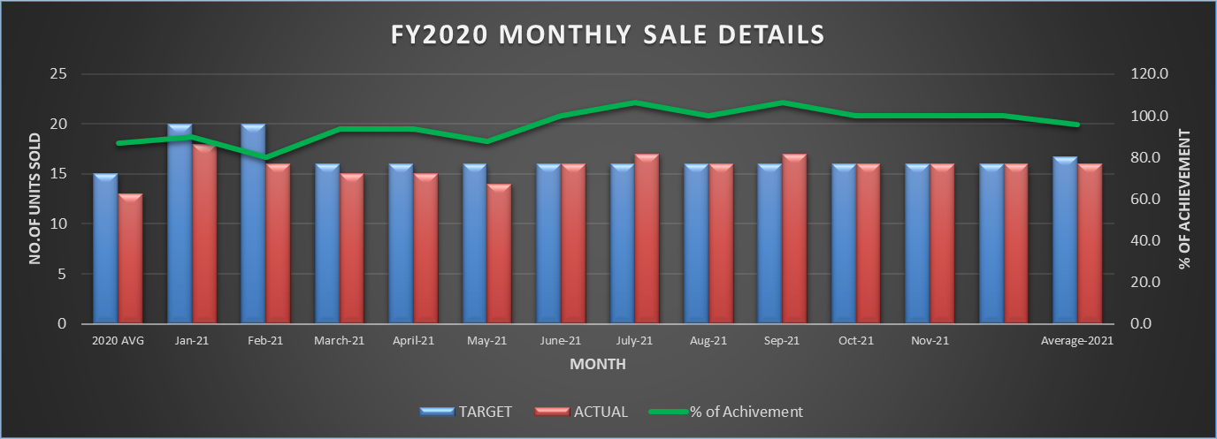
GROUP PERFORMANCE TRACKING SCREEN
PRISM
PRactical Improvement in Sales & Marketing
Back to Main Screen
From
To
BRANCH
HUB
SUB HUB
SALES ENGINEER
TEAM LEADER
MANAGER
MODEL
SALE Details
Calls to Lead Ratio
Leads to Prospect Ratio
Prospect to Sale Ratio
Calls to Sale Ratio
Export
28

Slide 47
PRISM
Service Engineer and Team Leader Live Location

Slide 48
LIVE LOCATION VIEW SCREEN
ZOOM IN TO VIEW ACCURATE GPS LOCATION
KAMAL
RAS AL KHAIMA
ROHITH
FUJAIRAH
DIBBA
RAKESH
DUBAI
AL QUOZ
KIRAN
ABU DHABI
MUSAFA
RANJITH
ABU DHABI RIWAIS

Slide 49
PRISM
MANAGER / OWNER VIEW SCREEN

Slide 50
LIVE LOCATION VIEW SCREEN
ZOOM IN TO VIEW ACCURATE GPS LOCATION
KAMAL
RAS AL KHAIMA
ROHITH
FUJAIRAH
DIBBA
RAKESH
DUBAI
AL QUOZ
KIRAN
ABU DHABI
MUSAFA
RANJITH
ABU DHABI RIWAIS

Slide 51
DASH BOARD – ACTUAL VS TARGET
YEAR / MONTH
HUB
APPLICATION
JAN-2021
SALES ENGINEER
SUB-HUB
SEGMENTATION
MOVE YOUR CURSOR TO VIEW DETAILS

Slide 52
Dashboard – Manager View
PRISM
PRactical Improvement in Sales & Marketing
Back to Main Screen
 | I | Q | D | N | F
 | 136 | 62 | 15 | 28 | 14
HUB-1 | 39 | 16 | 5 | 10 | 5
HUB-2 | 45 | 16 | 3 | 8 | 4
HUB-3 | 32 | 18 | 4 | 6 | 3
HUB-4 | 20 | 12 | 3 | 4 | 2

Slide 53
THANK YOU

