Slide 2
WELCOME TO ALL

Slide 3
ORGANIZATIONAL CHART
CEO
Deputy Director – Aftersales
National Service Manager
Service Manager
DXB & North
Workshop Manager
DXB & North
Workshop Manager
AUH
Service Teams
Service Teams
Service Teams
Warranty Dept.
Admin. Dept.

Slide 4
KEY METRICS OF SERVICE BUSINESS
F
C
P
R
ustomer
esource
inancials
rocess
Training
THD Asist
Thought of the Day
Suggestions
Employee Engagement Survey
KPI
Revenue Generation Process
CRM
Highmessaging
Job Flow
Preventive Maintenance Agreement Tracker
ChatBot(Demo 1 & 2)

Slide 5
KEY METRICS OF SERVICE BUSINESS
F
C
P
R
ustomer
esource
inancials
rocess
Training
THD Asist
Thought of the Day
Suggestions
Employee Engagement Survey
KPI
Revenue Generation Process
CRM
Highmessaging
Job Flow
Preventive Maintenance Agreement Tracker
ChatBot(Demo 1 & 2)

Slide 6
How To Drive Your Service Business Through KPI’s
KPI stands for Key Performance Indicator
Quantifiable measure of performance over time for specific objective.
KPIs provide targets to shoot for milestones to gauge progress, and insights that help people across the organization
Make better decisions in profitable in Business development

Slide 7
Key Performance Indicators Will Help You to Take Off

Slide 8
KPI CONSITS OF
Productivity
Technical Efficiency
Invoice Efficiency
Charge Rate
Break-Even

Slide 9
PRODUCTIVITY
Base Requirement
Enquiry / Complaints from Customer
System/Application
Enquiry registration
Job card creation
Task Creation
Standard hrs/ Estimated hrs updation
Task Allocation
Technician Availability
Tab device for in house / on field updates
Productivity Formula
Productive hrs / Available Hrs
Impact and Actions
Turn over
Margins
Net Profit
Break- even level
Increase sales
Awareness
Pre plan
Management
Target >85-90%

Slide 10
TECHNICAL EFFICIENCY
Base Requirement
System/Application
Job card creation
Task Creation
Task Allocation
Standard hrs/ Estimated hrs
Task Allocated Hrs
Booked Hrs
Tab device for in house / on field updates
Technical Efficiency Formula
Task Allocated hrs/Total Booked Hrs
Impact and Actions
Turn over
Bay Time
Margins
Net Profit
Break- even level
Supervision
Gap Findings
Planning
Training
Target >100%

Slide 11
INVOICE EFFICIENCY
Base Requirement
System/Application
Job card creation
Task Creation
Task Allocation
Standard hrs/ Estimated hrs
Booked Hrs
Invoice Hrs
Tab device for in house / on field updates
Invoice Efficiency Formula
Invoiced Hrs/Productive Hrs
Impact and Actions
Profitability
Net Profit
Break- even level
Supervision
Planning
Monitoring
Target >100%

Slide 12
CHARGE RATE
Base Requirement
System/Application
Job card creation
Task Creation
Task Allocation
Standard hrs/ Estimated hrs
Booked Hrs
Invoice Hrs
Charge Rate Formula
Total Labor sales/Total Invoice Hrs
Impact and Actions
Turn over
Margin
Profit
Competition
Perception
Trust
Market study
Differentiate rate
Package
Reduce Cost

Slide 13
BREAK EVEN
Base Requirement
System/Application
Direct and Indirect Expense cost
Material Expense cost
Revenue details
Invoiced hrs
Break-even Formula
Total Expense/Available Hrs
Impact and Actions
Charge rate
Margin
Profit
Competition
Perception
Trust
Reduce Cost
Increase Invoiced hrs
Engage Team

Slide 14
Total Calendar Time
Total Attendance Time
Productive Time
Improvement Area
Sick leave, vacation, unauthorized absence, etc.
Unsold time:
Idle time
Other unsold time

Slide 15
ACTIONS
Set Target First: Recalculate break-even level @ 85% productivity.
Easy Wins: Eliminate all jobs at loss.
All Onboard: Train and engage all staff.
Act: Push Productivity towards 85%.
Push: Efficiency to 100% or beyond

Slide 16
KPI REPORT
Example 1:
Hours to sell in a month: 200
Cost/mech/mth: USD 2,000
Cost per available hour: USD 10
Productivity: 50%
Hours invoiced: 100
Cost/invoiced hour: USD 20
Charge rate at 75% Gross Margin USD 80
Example 2:
Hours to sell in a month: 200
Cost/mech/mth: USD 2,000
Cost per available hour: USD 10
Productivity: 85%
Hours invoiced: 170
Cost/invoiced hour: USD 12
Charge rate at 75% Gross Margin USD 48

Slide 17
Customer Relationship Management with ZOHO
Daily Call visit Plan
Customer & Equipment Database
Lead Management
Marketing Process
Sales Funnel
Service Campaign
Monthly Review
Detailed Presentation

Slide 18
PROCESS FLOW - MACHINE CARE & MAINTENANCE
MACHINE MONITORING
MACHINE COMMENCEMENT
PDI
STOCK MAINTENANCE
MACHINE RECEIPT INSPECTION
MACHINE RECEIPT
SKILLED SERVICE TEAM MEMBERS
( OEM TRAINED & CERTIFIED )
SET PROCESS
SKILL EVALUTION & ENHANCEMENT
CLEAR TARGETS / RESP. FOR INDIVIDUAL & GROUP
PERIODICAL MARKET BENCHMARK STUDY
FINISHED GOODS PRODUCT AUDITS
QUALITY REVIEW WITH CASE AREA SERV.MANAGER
COMMITTED MANAGEMENT
AREA SERVICE MANAGER

Slide 19
MACHINE RECEIPT INSPECTION
TECHNICIAN
WORK SHOP MANAGER
SERVICE ADMIN.
SALES ADMIN.
SALE’S WORK ORDER
REVIEW & JOB ACCEPTANCE
REVIEW & JOB ALLOCATION
JOB CARD OPENING
AL SHIRAWI ORDER SPECIFICATION
MACHINE RECEIPT

Slide 20
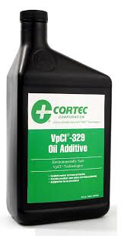
MACHINE RECEIPT INSPECTION
WORK ORDER CLOSURE AND COMMUNICATION TO SALES
NO OBSERVATIONS
BEST PRACTICES
SERVICE ADMIN.
SALES ADMIN
REVIEW & CLOSE JOB CARD
STOCK MAINTENANCE
MACHINE RECEIPT
INSPECTION
WORK SHOP MANAGER
VPCI 368
VPCI 705
ANTI RUST SPRAY FOR FUEL TANKS
ANTI RUST PROTECTION FOR CYLINDER RODS
TECHNICIAN

Slide 21
MACHINE RECEIPT INSPECTION
REVIEW & COMMUNICATE TO WORKSHOP MANAGER
JOB CARD OPENING
PARTS ORDERING
WORK SHOP MANAGER
SERVICE ADMIN
REVIEW SOLUTION AND ADVICE FOR JOB CARD OPENING
JOB ALLOCATION
WORK SHOP MANAGER
RESOLUTION & UPDATION IN HM
RE-INSPECTION OF MACHINE
MOVE MACHINE TO STOCK YARD
WARRANTY ADMIN
REVIEW UPDATE & CLOSE TICKET
RECEIVE UPDATE ON FURTHER PROCEEDINGS FROM MANITOU
UPDATE SERVICE ADMIN OBSERVATIONS & STATUS
OBSERVATIONS NOTED
TECHNICIAN
UPDATE WARRANTY ADMIN ON JOB COMPLITION DETAILS
UPDATE SALES RECORDS & RELEASE BLOCK STOCK
UPDATE SERVICE ADMIN ON OBSERVATIONS & STATUS
UPDATE STATUS IN WEB PORTAL
WORK SHOP MANAGER
MACHINE RECEIPT
INSPECTION
UPDATE SALES ADMINON ON MACHINE STATUS & CLOSE JOB CARD
WARRANTY ADMIN
UPDATE WARRANTY ADMIN ON OBSERVATIONS & DETAILS
SERVICE ADMIN
SALES ADMIN
UPDATE OBSERVATIONS IN WEB PORTAL
BLOCK SL.NO FROM MACHINE SALE
UPDATE SALES ADMINON BLOCK STOCK & WORK ORDER CLOSURE
TECHNICIAN

Slide 22
STOCK MAINTENANCE
JC CLOSURE & COMMUNICATION TO SALES
REVIEW & CLOSE JOB CARD
SERVICE ADMIN
SALES ADMIN
NO OBSERVATIONS
JC OPENING
BEST PRACTICES
WORK SHOP MANAGER
SERVICE ADMIN
ASSIGN JC
STOCK MAINTENANCE
TECHNICIAN
WORK SHOP MANAGER
VPCI 368
VPCI 705
ANTI RUST SPRAY FOR FUEL TANKS
ANTI RUST PROTECTION FOR CYLINDER RODS
TECHNICIAN

Slide 23
STOCK MAINTENANCE
REVIEW & COMMUNICATE TO WORKSHOP MANAGER
JOB CARD OPENING
PARTS ORDERING
WORK SHOP MANAGER
SERVICE ADMIN
REVIEW SOLUTION AND ADVICE FOR JOB CARD OPENING
JOB ALLOCATION
WORK SHOP MANAGER
RESOLUTION & UPDATION IN HM
RE-INSPECTION OF MACHINE
MOVE MACHINE TO STOCK YARD
WARRANTY ADMIN
REVIEW UPDATE & CLOSE TICKET
RECEIVE UPDATE ON FURTHER PROCEEDINGS FROM MANITOU
UPDATE SERVICE ADMIN OBSERVATIONS & STATUS
OBSERVATIONS NOTED
TECHNICIAN
UPDATE WARRANTY ADMIN ON JOB COMPLITION DETAILS
UPDATE SALES RECORDS & RELEASE BLOCK STOCK
UPDATE SERVICE ADMIN ON OBSERVATIONS & STATUS
UPDATE STATUS IN WEB PORTAL
WORK SHOP MANAGER
STOCK MAINTENANCE
UPDATE SALES ADMINON ON MACHINE STATUS & CLOSE JOB CARD
WARRANTY ADMIN
UPDATE WARRANTY ADMIN ON OBSERVATIONS & DETAILS
SERVICE ADMIN
SALES ADMIN
UPDATE OBSERVATIONS IN WEB PORTAL
BLOCK SL.NO FROM MACHINE SALE
UPDATE SALES ADMINON BLOCK STOCK & WORK ORDER CLOSURE
TECHNICIAN

Slide 24
PRE-DELIVERY INSPECTION
PRE – DELIVERY INSPECTION
TECHNICIAN
WORK SHOP MANAGER
SERVICE ADMIN.
SALES ADMIN.
SALE’S WORK ORDER
AL SHIRAWI ORDER SPECIFICATION
REVIEW & JOB ACCEPTANCE
REVIEW & JOB ALLOCATION
JOB CARD OPENING
PDI - 2
PAINT TOUCHUP
PDI - 1
WASHING
PAINTER
TECHNICIAN
TECHNICIAN
TECHNICIAN

Slide 25
PRE – DELIVERY INSPECTION
TECHNICIAN
WORK SHOP MANAGER
SERVICE ADMIN.
SALES ADMIN.
OBSERVATIONS & COMMENTS IN HM
REVIEW & JOB CARD CLOSURE
JOB CARD CLOSING AND COMMUNICATION
PROCESSING FOR MACHINE DELIVERY
READY FOR DISPATCH
PDI 2

Slide 26
MACHINE DELIVERY & ONSITE COMMENCEMENT
SALES
REPRESENTATIVE
TRAINER
( PRE-EVALUATION / TRAINING / POST EVALUATION )
SALES
REPRESENTATIVE
CUSTOMER
SALES
REPRESENTATIVE
PRE-EVALUATION
OVER VIEW OF OPERATOR MANUAL
DAILY MAINTENANCE
BEST PRACTICES
EXECUTE TRAINING
PREVENTIVE MAINT.
ONSITE DELIVERY
PREDICTIVE MAINT.
COMMENCEMENT
SHARE SERVICE CONT
INVITE NOMINEES FOR TRAINING
POST-EVALUATION
SCHEDULE TRAINING
NOMINATION OF TRAINEES
CERTIFICATION
MACHINE DELIVERY & ONSITE COMMENCEMENT
MACHINE PRE - DELIVERY
READY FOR DISPATCH

Slide 27
MACHINE MONITORING
DEDICATED TECHNICIAN
CUSTOMER / USER
PRODUCT SUP.REP
INSPECTION
UPDATE IN THD
OPEN JC & ORDER PARTS
INFORMATION TO CUSTOMER
COMPLETE JOB
INFORM CUSTOMER
WARRANTY CLAIM
UPDATE IN THD
INSPECTION
QUOTATION
QUOTE APPROVAL
JOB COMPLETION
INFORMATION TO CUSTOMER
INFORMATION TO CUSTOMER
JOB CARD & PARTS ORDER
WARRANTY PROCESS CYCLE
REPAIR QUOTE CYCLE

Slide 28
CUSTOMER RELATIONSHIP & PREVENTIVE MAINTENANCE
PRODUCT SUPPORT
REPRESENTATIVE
REQUEST CUSTOMER
APPOINTMENT & SCHEDULE MEETING
DISCUSS ON PREVENTIVE MAINTENANCE
OFFER PREVENTIVE MAINTENANCE AGREEMENT
1
NO
ACCEPTANCE
YES
OFFER PREVENTIVE MAINTENANCE INSPECTION AGREEMENT
2
GET DOCUMENTS SIGNED & PROCESS CREDIT FACILITY
NO
ACCEPTANCE
PERFORM SERVICE AS PER SCHEDULE
YES
GET DOCUMENTS SIGNED & PROCESS CREDIT FACILITY
SERVICE REPORT COMMUNICATION TO CUSTOMER
3
HAND OVER
PM DETAILS &
CONTACT DETAILS FOR ANY ASSISTANCE
PERFORM INSPECTION AS PER SCHEDULE
MACHINE MONITORING PROCESS

Slide 29
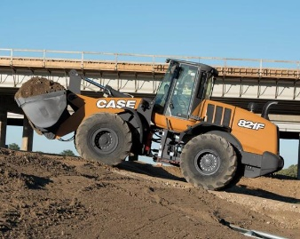
CUSTOMER RELATIONSHIP & PREVENTIVE MAINTENANCE
JOINT PRODUCT AUDITS – ON SITE
CASE AREA SERVICE MANAGER
PRODUCT SUPPORT REPRESENATIVE
RATING & NOMINATION OF BEST USER
REWARDS

Slide 30
LEVELS OF TRAINING
Expert
Major circuit reading, Trouble shooting, Problem Solving, Pressure Test and Adjustment
Product
Excavator, Wheel Loader ,Backhoe Loader, Skid Steer, Motor Grader, Compactor and Telehandler
Advance
Hydraulic, Electrical, Engine & Transmission
Intermediate
Hydraulic, Electrical, Engine & Transmission
Basic
Hydraulic, Electrical, Engine & Transmission

Slide 31
INFORMATION OF TRAININGS
After the completion of one training the trainees are eligible for the next level of training.
80% Minimum score required to promote next level
Trainees are not eligible for the product training if they don't clear Advance training of all subject
One certificate for one sets of training ( i.e Hyd. Ele. Eng. Trns. & Product)
Expert training can be conduct after and before Product Training
If score less than in internal exam the trainees has to reappar for trainings

Slide 32
Technician Level
Sr.No | Name |  | Level
1 | PANKAJ | SINGH | Expert
2 | SONA | SHANMUKHAN | Expert
3 | GOPALAKRISHNAN | NARAYANASWAMI | Expert
4 | KUMARAVEL | MOLAVACHARI | Expert
5 | RAJESWARARAJ | PAULRAJ | Expert
6 | HARIDAS | PALANI | Expert
7 | MOAZZAM ALI | Mazhar | Expert
8 | DEEPAK | Kumar | Expert
9 | AHMAD | Al Sharabi | Expert
Sr.No | Name |  | Level
1 | VIPIN | Vinson | Intermediate
2 | ANOOP | PILLAI | Intermediate
3 | BALAKRISHNAN | Varadharajan | Intermediate
4 | Shravan | Kumar | Intermediate
5 | THUSANTHA | Asurumuni | Intermediate
Sr.No | Name |  | Level
1 | Nijin |  | Basic
Sr.No | Name |  | Level
1 | VIPIN | PAKKATH BHASKARAN | Advance
2 | RAJIV GANDHI | SELVAM | Advance
3 | SYED ANVAR | MOHAMMED | Advance
4 | SANDEEP | PV | Advance
5 | SAJEEV | CK | Advance
Sr.No | Level | Numbers of Technician
1 | Expert | 9
2 | Advance | 5
3 | Intermediate | 5
4 | Basic | 1

Slide 33
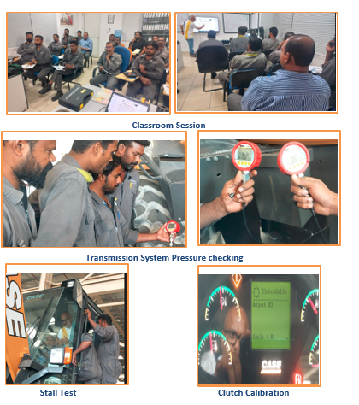
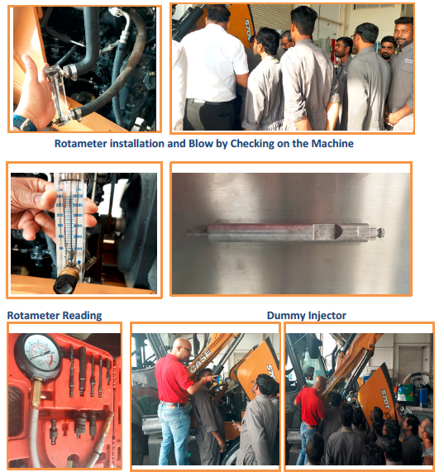
Training Pictures

Slide 34
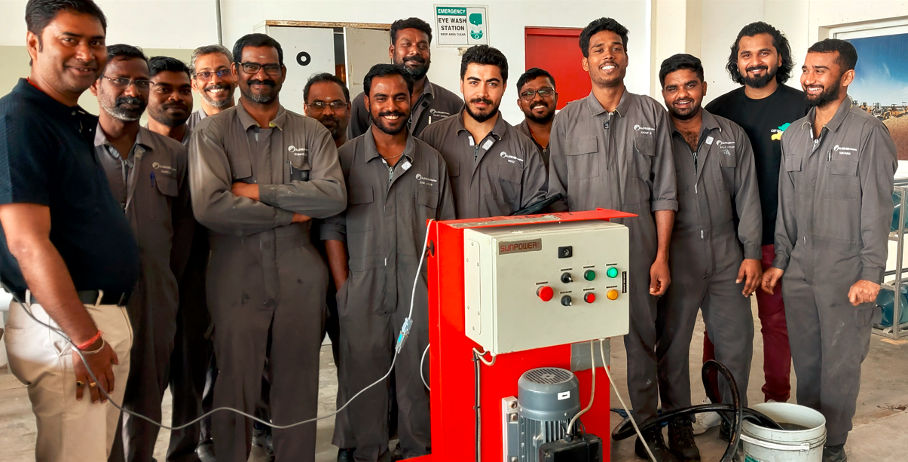
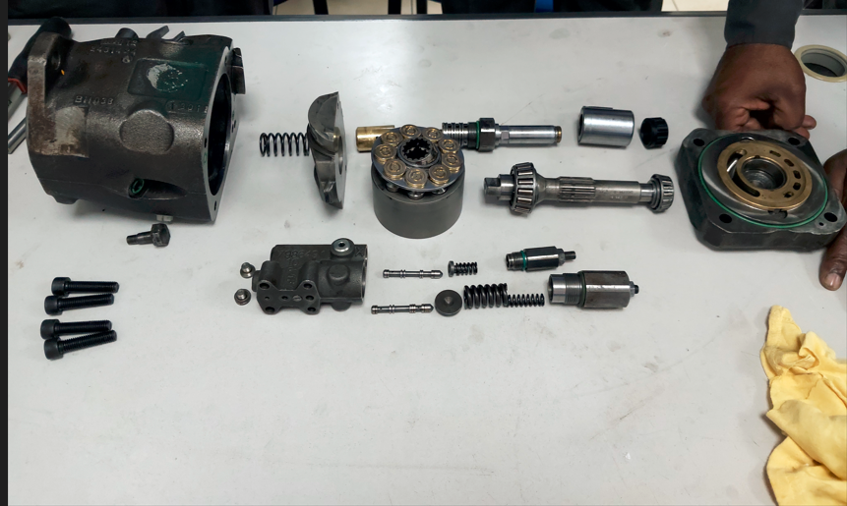
Training Pictures
Filtration Training
Hydraulic Component Training Blow-By Test

Slide 35
THANK YOU

